Slide 1
New Segmentation Technique
Speaker: Yu-Hsiang Wang
Advisor: Prof. Jian-Jung Ding
Digital Image and Signal Processing Lab
Graduate Institute of Communication Engineering
National Taiwan University

Slide 2
Outline
Introduction
JSEG
  Criterion for Segmentation
  Seed Determination
  Seed Growing
  Region Merge
GrabCut
  Iterative minimization
  User editing
Conclusion

Slide 3
Introduction
We introduce two segmentation methods in this report: JSEG and GrabCut.
JSEG is based on the concept of region growing.
GrabCut is an interactive foreground/background segmentation in image.

Slide 4
JSEG[1]
[1]

Slide 5
JSEG(Criterion for Segmentation)
A color quantization algorithm is applied to image. [2]
Each pixel is assigned its corresponding color class label.
Estimate region by J value:
S_{T} and S_{W} are an variance.

Slide 6
JSEG(Criterion for Segmentation)
Total variance
  where z is coordinate and m is mean of coordinate.
Mean of variance of each class
  where m_{i} is the mean coordinate of class Z_{i}.

Slide 7
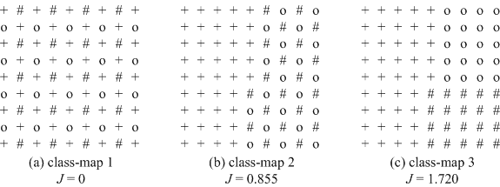
JSEG(Criterion for Segmentation)
An example of different class-maps and their corresponding J values.

Slide 8
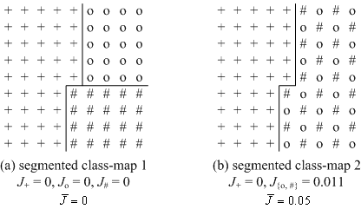
JSEG(Criterion for Segmentation)
Segmented class-map and value
number of points in region k

Slide 9
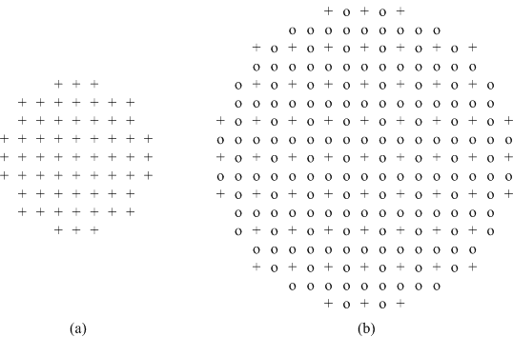
JSEG(Criterion for Segmentation)
Use local J value to implement region growing, where local J compute by windows:
Scale 1
Scale 2

Slide 10
JSEG
[1]

Slide 11
JSEG(Seed Determination)
Step 1: Compute the average and the standard deviation of the local J values.
Step 2: Set threshold
Step 3: Pixels with local J values less than T_{J} are set as candidate seed points.

Slide 12
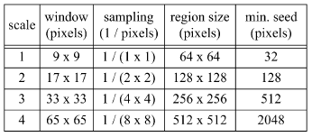
JSEG(Seed Determination)
Step 4: Associate candidate seed points as seed area if its size larger than minimum size.

Slide 13
JSEG
[1]

Slide 14
JSEG(Seed Growing)
Step 1: Remove “holes” in the seed areas.
Step 2: Compute the average of the local J values in the remaining unsegmented part of the region.
Seed area
hole
Seed area

Slide 15
JSEG(Seed Growing)
Step 3: Connect pixels below the average to compose growing areas.
Step 4: If a growing area is adjacent to one and only one seed, we merge it into that seed.
Seed area

Slide 16
JSEG(Seed Growing)
Step 5: Compute local J values of the remaining unsegmented pixels at the next smaller scale and repeat region growing.
Step 6: At the smallest scale, the remaining pixels are grown one by one.
Seed area

Slide 17
JSEG
[1]

Slide 18
JSEG(Region Merge)
Use color histogram to determine if two regions can be merged or not.
The Euclidean distance between two color histograms i and j :
This method is based on the agglomerative method. [3]

Slide 19
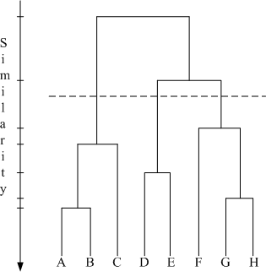
JSEG(Region Merge)
Hierarchical agglomerative algorithm:
[3]

Slide 20
JSEG(Segmentation Results)
[1]

Slide 21
JSEG(Segmentation Results)
[1]

Slide 22
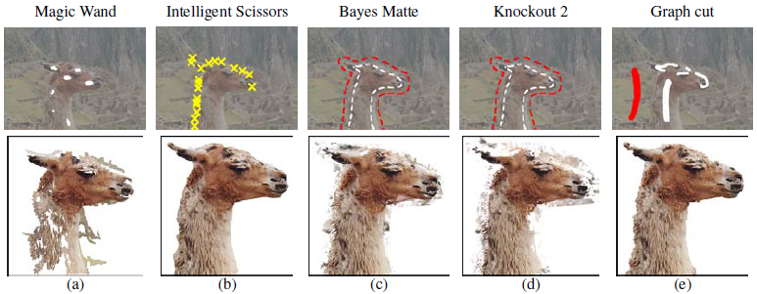
GrabCut [5]
Interactive tool for segmentation.
Several method:

Slide 23
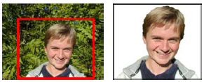
GrabCut
Color data modeling
  Gaussian Mixture Model (GMM)
    Background GMM and foreground GMM
    full-covariance Gaussian mixture with K components (typically K = 5).
Iterative energy minimization

Slide 24
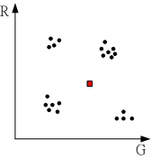
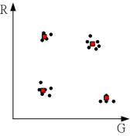
GrabCut(Gaussian Mixture Model)
Why do not use one Gaussian distribution to model foreground(or back)
Posit RG distribution of data foreground
Use one Gaussian distribution model
Use Gaussian mixture model

Slide 25
GrabCut(Gaussian Mixture Model)
Gaussian Mixture Model
  Compute the probability of assigning component j to data i, i is the no. of data and j is the no. of component.
j=1
j=3
j=4
j=2
Notes:
和K mean 不同之處在於，K mean每一個pixel只對一群有影響，而GMM每一個pixel對每個component都有影響力(因為是算被歸類成每一個的機率)

Slide 26
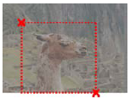
GrabCut(Initialization)
User initializes trimap T, the background is set T_{B}, foreground T_{F} is empty and
for and for .
Initialize background and foreground GMMs from sets and .
T_{B}
T_{U}

Slide 27
GrabCut(Iterative minimization)
Step 1: Assign GMM components to pixels, for each n in T_{U}.
where
data
mixture weighting coefficients
Gaussian probability distribution
Notes:
這一步會根據前景與背景的GMM，來決定每個data是算前景or背景，下一步則是重新學習GMM的model參數

Slide 28
GrabCut(Iterative minimization)
Step 2: Learn GMM parameters from data z.
where
Account of color GMM models
Notes:
根據前一步重新分類的前景與背景點，來修正前景與背景的GMM model參數

Slide 29
GrabCut(Iterative minimization)
Step 3: Estimate segmentation by using min cut.
where
Repeat from Step 1 until convergence.
color GMM model
Smoothness term
Notes:
猜測這一步是根據前兩步得到的結果，重新估計T_{U}的範圍 (T_{B}的補數)

Slide 30
GrabCut(Iterative minimization)
Smoothness term
ensures the appropriate high and low contrast, depending on z_{m} and z_{n}.
50
set of pairs of neighboring
Notes:
Smooth term 猜測可能是為了影響color GMM model 作一些可能類似是前景又是背景的pixel做微調動作，方式是考慮其鄰居點的顏色與他的關係

Slide 31
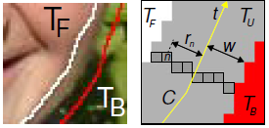
GrabCut(Border matting)
To smooth the boundary.
Begin with a closed contour C.
Apply dynamic programming algorithm for estimating throughout T_{U}.
Notes:
經過前面Iterative minimization的處理後已經得到前景與背景，因此可以畫出Contour C，根據C可以畫出一條封閉線(黃)，在圈出寬度為2w的T_{U}區域對此處重新做分配這部份的點為前景或背景。主要是運用DP對這些點作運算，因為DP可以去設定說顏色比較相近的點連續的話，weight比較重(ex: 我是皮膚色，下一點也是皮膚色的可能性上升，因把不是皮膚色的點設為背景)，這樣重新分配的前景就會比較smooth

Slide 32
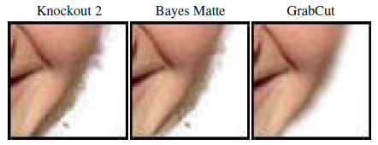
GrabCut(Border matting)
Border matting result:

Slide 33
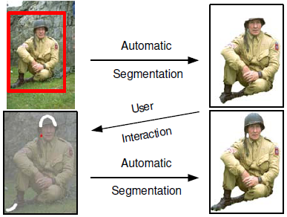
GrabCut(User editing)

Slide 34
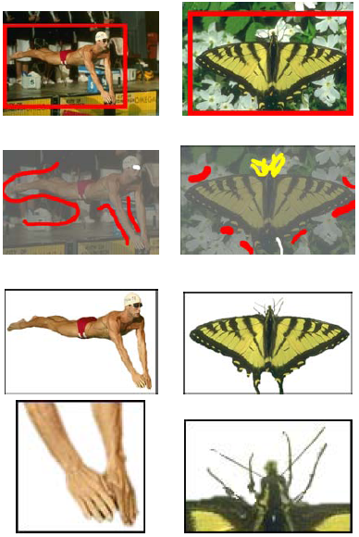
GrabCut(Segmentation Results)

Slide 35
Conculsion
JSEG
  It both considers the similarity of colors and their distributions.
  Performance is better than Region growing and its time cost also small.
GrabCut
  It can be applied for some image processing software, e.g. Photoshop.
  Also for some interactive entertainment systems, e.g. Smartphone and video game.

Slide 36
Reference
[1] Y. Deng, and B.S. Manjunath, “Unsupervised segmentation of color-texture re-gions in images and video,” IEEE Trans. Pattern Anal. Machine Intell., vol. 23, no. 8, pp. 800-810, Aug. 2001.
[2] Y. Deng, C. Kenney, M.S. Moore, and B.S. Manjunath, “Peer group filtering and perceptual color image quantization,” Proc. IEEE Int'l Symp. Circuits and Systems, vol. 4, pp. 21-24, Jul. 1999.
[3] R.O. Duda and P.E. Hart, Pattern Classification and Scene Analysis. New York: John Wiley&Sons, 1970.
[4] A. K. Jain, M. N. Murty, and P. J. Flynn, “Data clustering: a review,” ACM Computing Surveys, vol. 31, issue 3, pp. 264-323, Sep. 1999.
[5] C. Rother, V. Kolmogorov, and A. Blake, “Grabcut: Interactive foreground extraction using iterated graph cuts,” ACM Transactions on Graphics, vol. 23, issue 3, pp. 309-314, Aug. 2004.

